Slide 1
Presentation Talking points
Intro and History of Stocks & Crypto - Xing
Stock Talking Point - Mauricio
Crypto Talking Point - Jarvis
Project Module - Xing
Gathering Data - Mauricio
Scraping/mongoDB - Mauricio
Dashboard, HTML, CSS, JS - Xing
Leaflet - Xing
Conclusion - Jarvis
Improvements for next time - Xing
Q&A - Everyone

Slide 2
Crypto & Stock Analysis
Team VIP (Visualization and Insightful Project)
By: Jarvis, Mauricio, Saurabh and Xing

Slide 3
Cryptocurrencies and Capital Market
Cryptocurrency Market x Stock Market
Accessibility of cryptocurrency in USA
Finding latest insights to cryptocurrency
Analysing historical data and looking for potential trends
Notes:
2008 Financial Crisis
The 2008 financial crisis is the worst economic disaster since the Great Depression of 1929.
In the crash, Dow jones had a record-breaking drop of 777.68 points which was a record until last year. Crash was championed by the housing market.
Stock market is a good representation the overall economy and a common and widely accepted investors way to park their money. But the risk is inherit within the centralized system.
Interestingly Bitcoin the first cryptocurency to come into existance in 2009, shortly after the crisis, Bitcoin is a decentralized digital currency that enables instant payments to anyone, anywhere in the world.
Bitcoin uses peer-to-peer technology to operate with no central authority, which allows transaction management and money issuance are carried out collectively by the network.
Bitcoin gained popularity because people saw it as a way to separate money from the state, another way to invest and diversify their portfolio.
Our project we tried to find any Trends between cryptocurrency and stock market.
My collagues will dive further into our findings

Slide 4


Stock Market Analysis
Notes:
Dow Jones: 1896
S&P 500: 1957
Dow Jones - 30 very large North American Companies picked by the Wall Street Journal Editors
S&P 500 - 500 large publicly traded American stocks - market cap of at least $5.3 billion and public float of 50%
They are both used as benchmarks

Slide 5
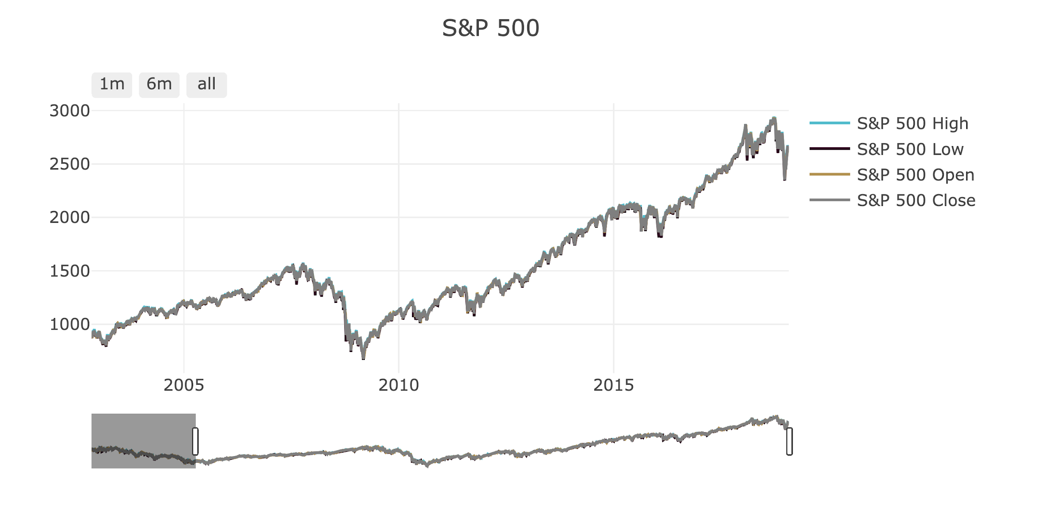
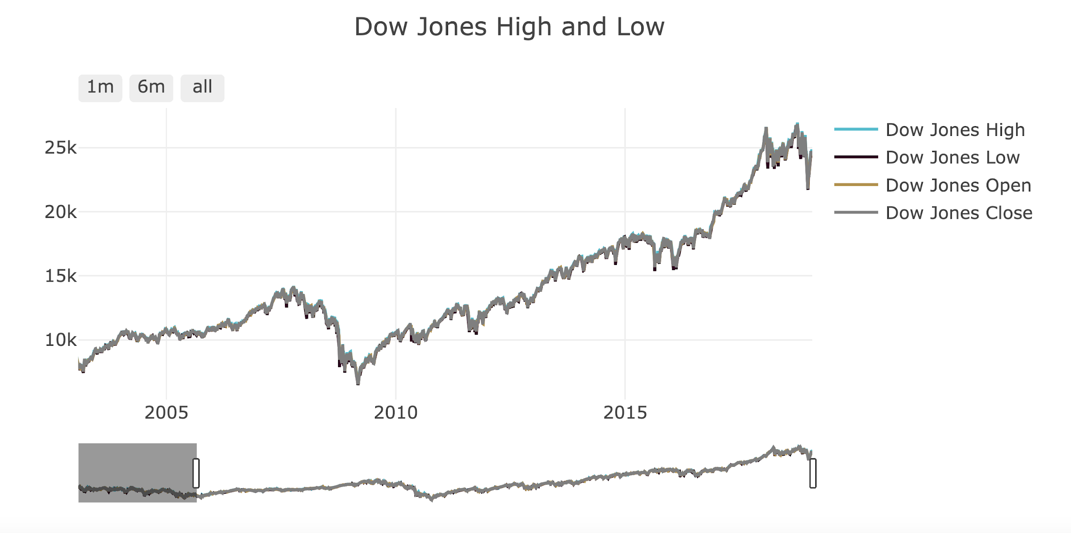
Stock Market Analysis
Over 70% increase
2007/2008 - real estate crisis
Quantitative Easing (QE) - over $3.5 TRILLION flow to the market
Unprecedented liquidity
Notes:
United States was deep into a financial crisis.
Interests rates were already close to zero
QE - buying trillions of dollars of government bonds and mortgage-backed securities
2009 - 2011 - 2013
Public debt always around 50% - today it is at 103% of the GDP
Debt: $22 trillion
GDP: $20 trillion

Slide 6

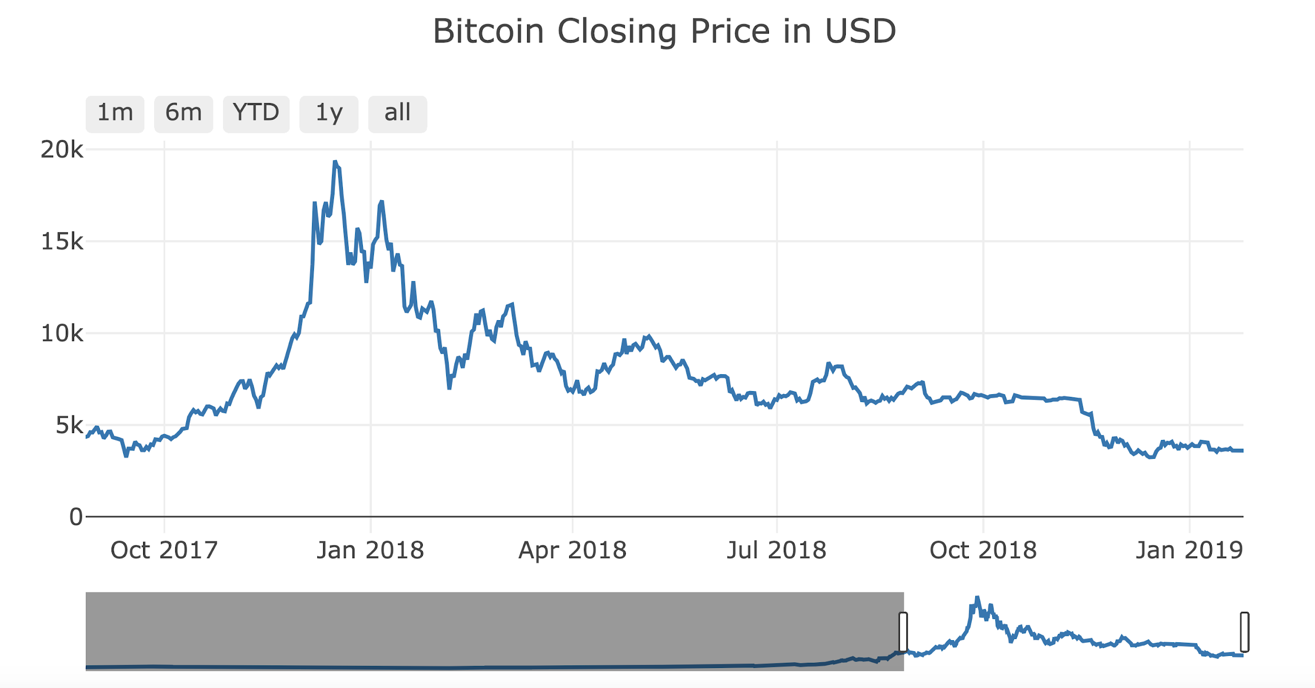
Bitcoin Analysis
How was Bitcoin influenced?
Brief history of bubble
Bearish - Symmetrical Triangle
Notes:
A bubble is when value greatly exceeds intrinsic value (questionably 0)
Huge Growth powered by influx of cash in economy + consumer hype
18.6% - 19.1%
41% - 42%

Slide 7
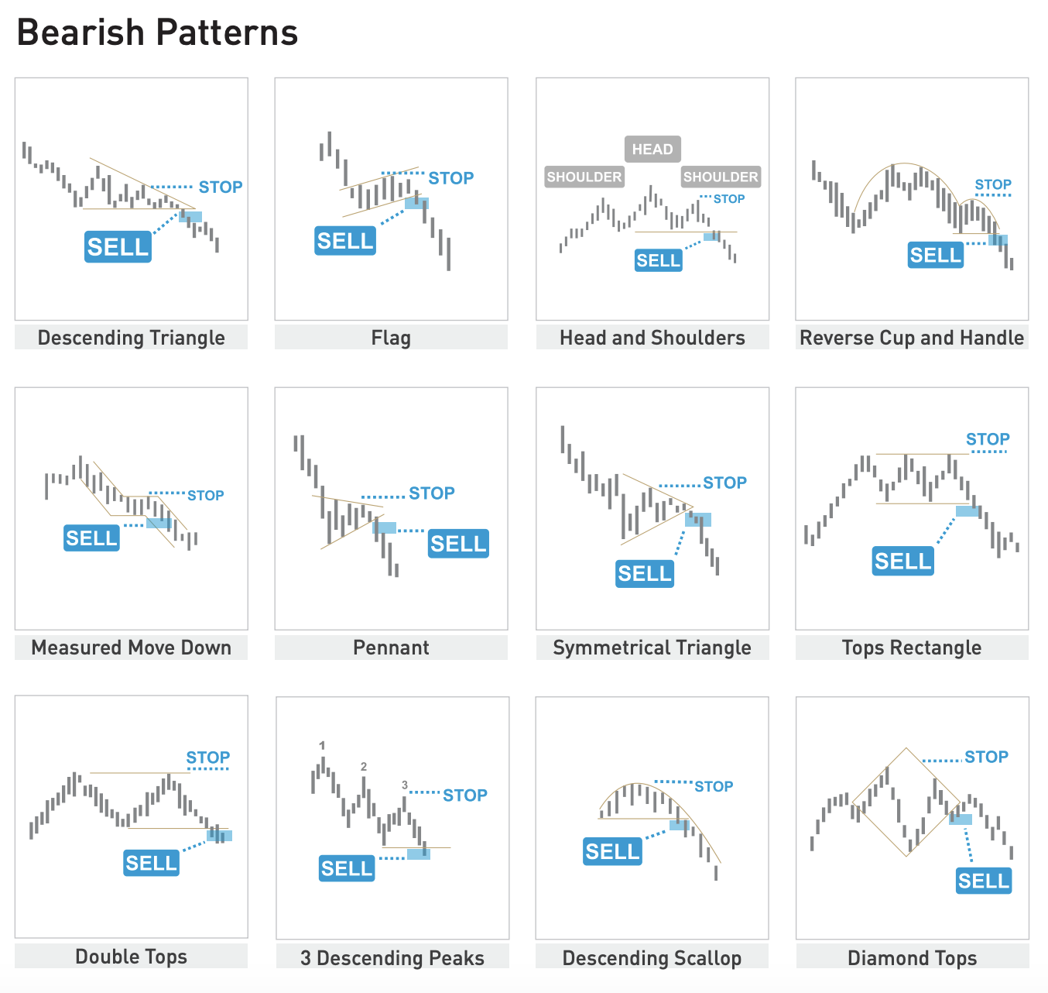
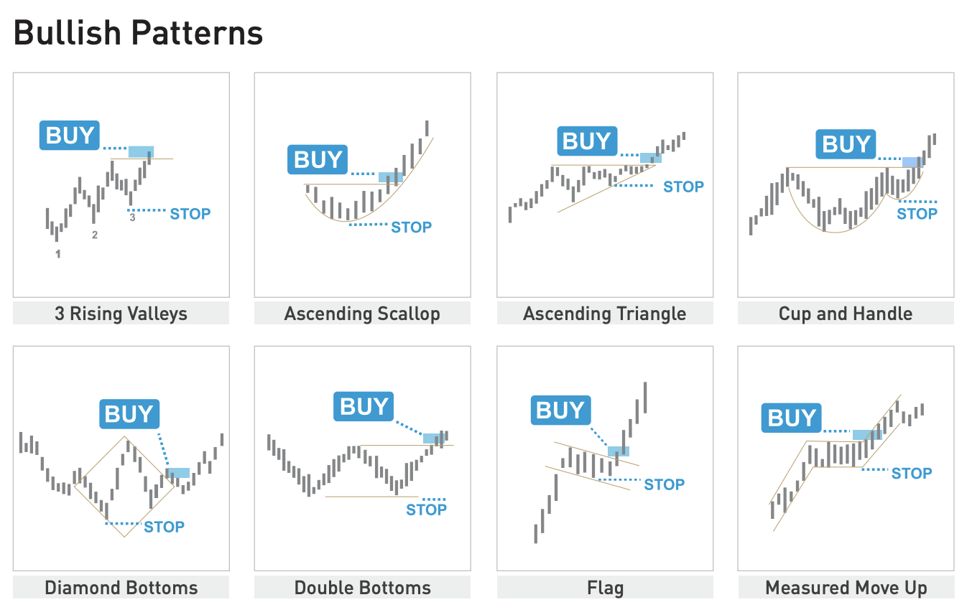
Trend Reading 101

Slide 8
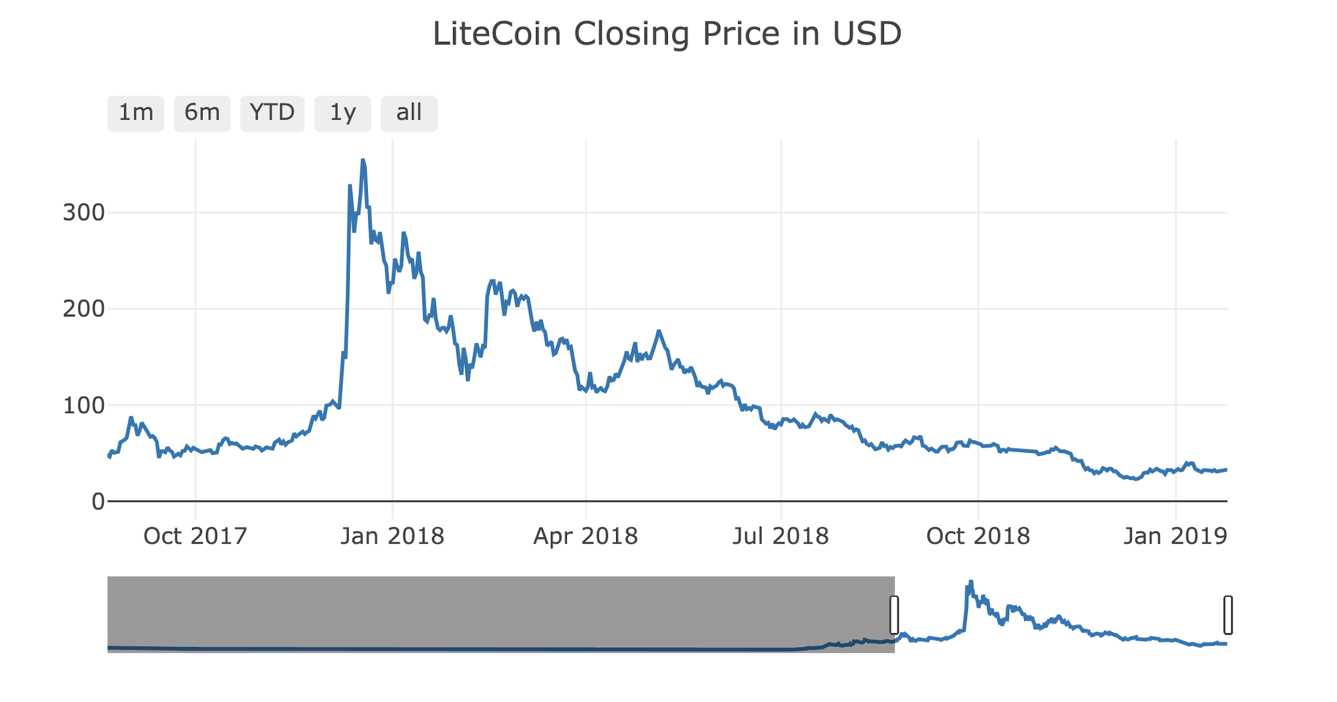
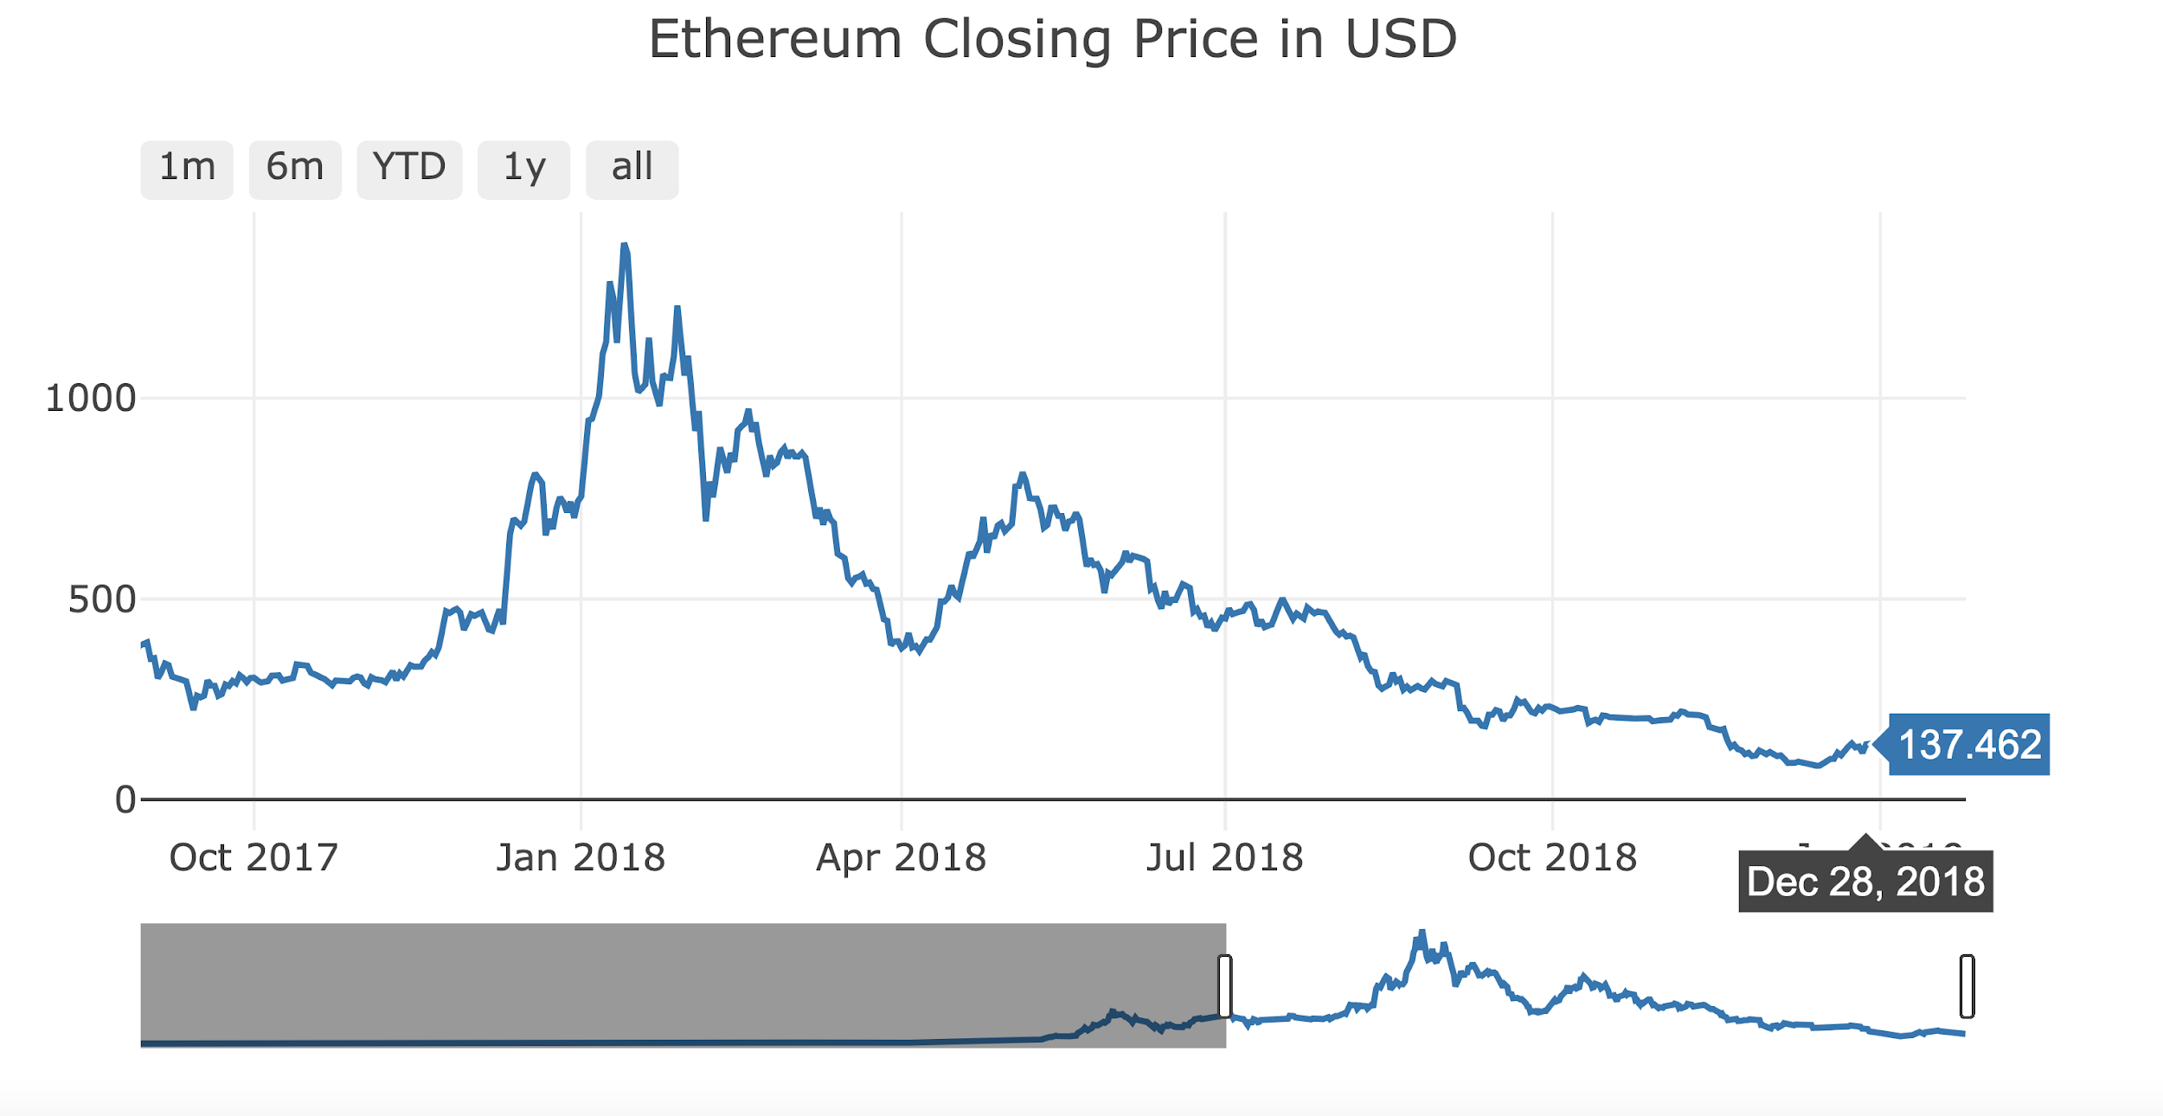
Crypto Analysis
How did Bitcoin influence other Cryptocurrencies?
1
2
3
Notes:
Main differences between bitcoin and other currencies = speed, energy usage, security & information stored beyond currency (validation/key encryption)
Bitcoin = Crypto index, follows
Litecoin = most influenced - descending peaks
Ethereum = greatest variance, but still on trend with Bitcoin (if you were a trader, you’d buy in on Litecoin/smaller currencies based on Bitcoin’s performance.

Slide 9

Notes:
DEMO Project

Slide 10
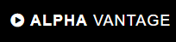
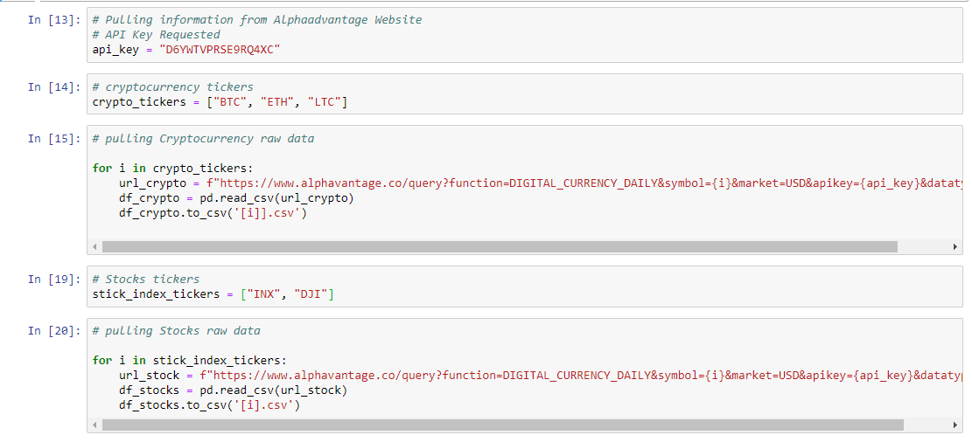
Gathering the data
Community of researchers, engineers, and business professionals.
APIs for realtime and historical data on stocks, forex (FX), and digital/crypto currencies.

Slide 11
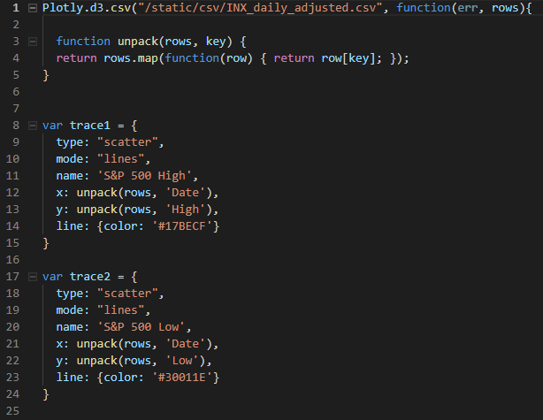
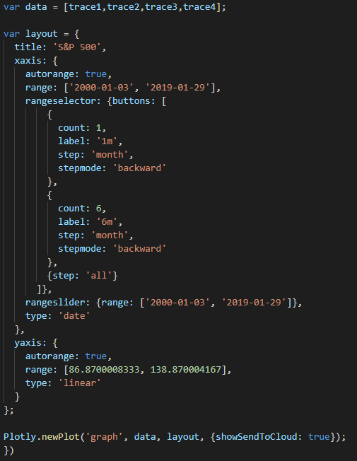
Using Plotly

Slide 12
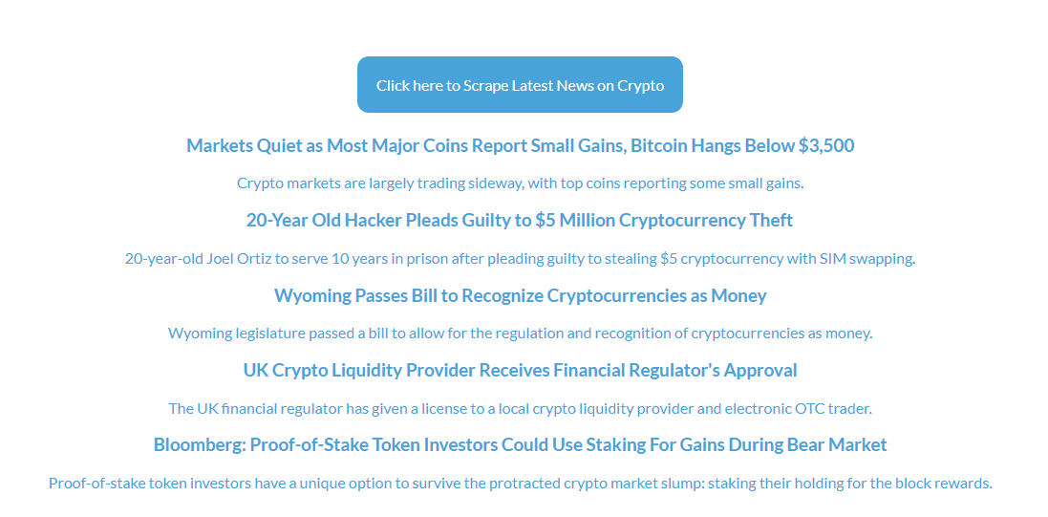
Cryptocurrency News - Cointelegraph

Slide 13
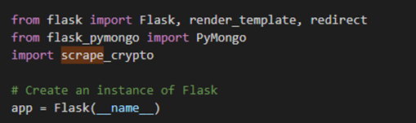
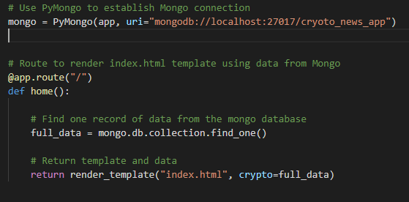
Scrapping Using Flask
Notes:
Establishing a Flask App
Used the PyMongo Library to establish a Mongo Connection which will create a database
Created a route to trigger the scrape function
Once this function runs, it visits the webpage and scrape elements from it saves it the data base
This process consists of creating a request to the webpage, then saving its response as data and then converting it into beautiful soup
Finally storing this into a dictionary in Mongo DB

Slide 14
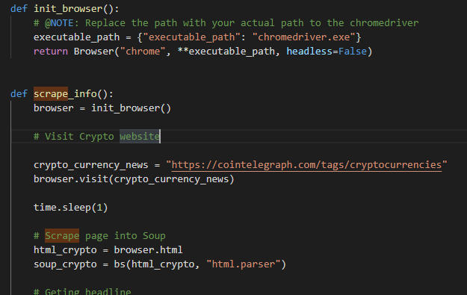
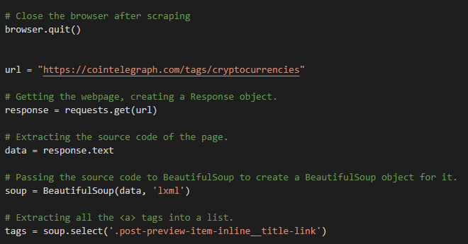
Scrapping Code
Notes:
Establishing a Flask App
Used the PyMongo Library to establish a Mongo Connection which will create a database
Created a route to trigger the scrape function
Once this function runs, it visits the webpage and scrape elements from it saves it the data base
This process consists of creating a request to the webpage, then saving its response as data and then converting it into beautiful soup
Finally storing this into a dictionary in Mongo DB

Slide 15
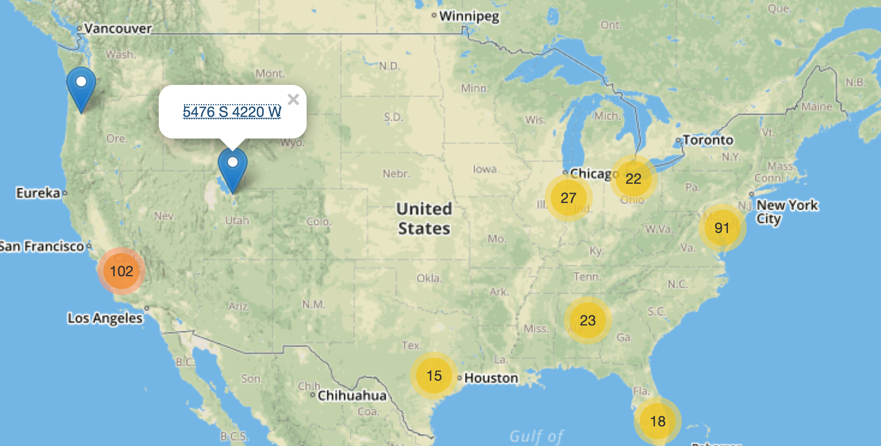
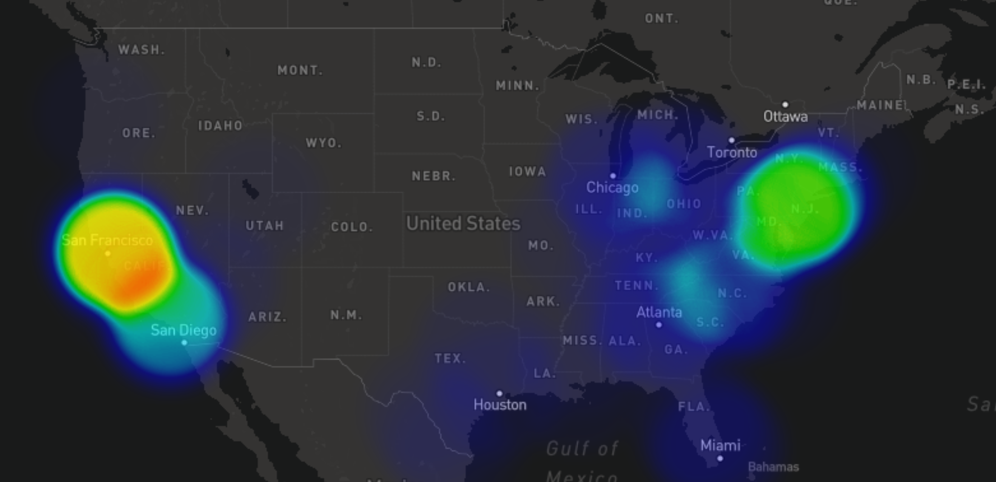
ATM locations
Mapped all US locations of Crypto ATMs using Leaflet
Market cluster used for a better view
Users can opt for Heatmap to check concentration of ATMs
Click on a marker takes users to street view
New JS library - anime.js used to
Animate the heading
Expand the map on page load

Slide 16
Conclusion
Analysis
Economically we are probably in a transition between a bear to bull market
The Bitcoin bubble was a result of global markets extreme growth & consumer hype
Bitcoin drove other currencies prices in bubble and continues too
Project
Clear communication, github and HTML: all points of success
Respect file paths
Improvements for next time:

